Slide 1
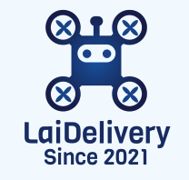
LaiDelivery
Dispatch & Delivery Management App Project
Make Delivery Easy & Fast
Team 3
Instructor:
Kevin
Frontend:
Jie Xu , Hengguang Li, Wenzheng Li
Backend:
Shaoshuai Xu (tech lead), Tianhao Han, Weike Yu, Hung-Hsi Lin, Mingcheng Li
System Design:
Shaoshuai Xu, Tianhao Han, Hung-Hsi Lin
2022.01.03

Slide 2
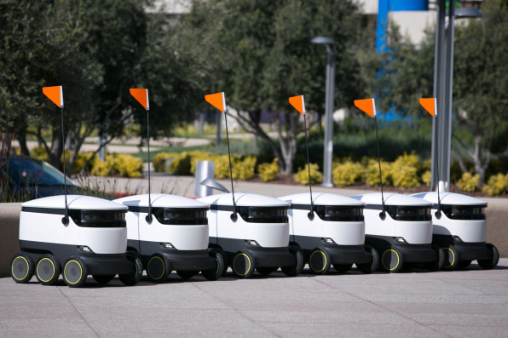
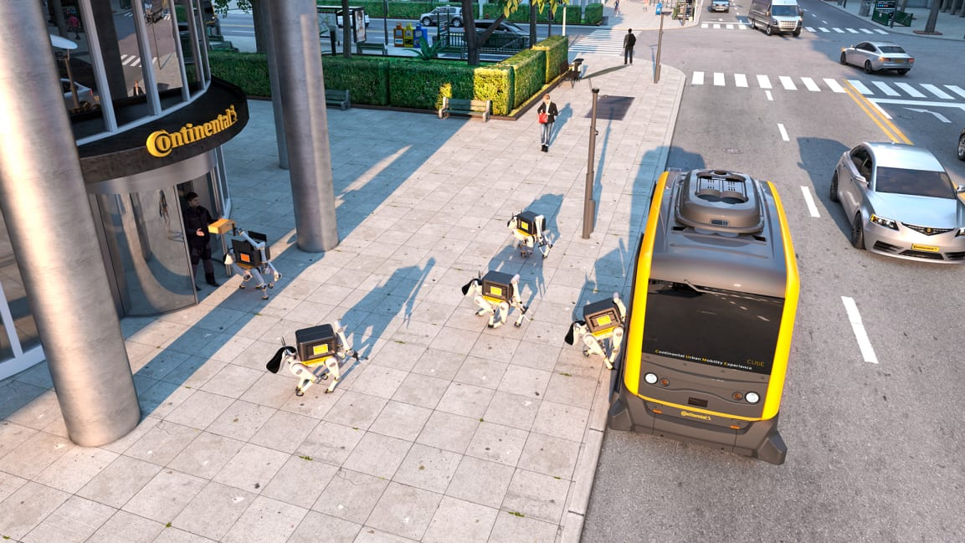
Outline
Background
User requirments & Key assumptions
Core features & Completed functionalities
Technical design
App details
Login/Register
Package info input
Options offered
Package list organization
Checkout
Tracking & notification
Demo
Product roadmap
Q & A

Slide 3

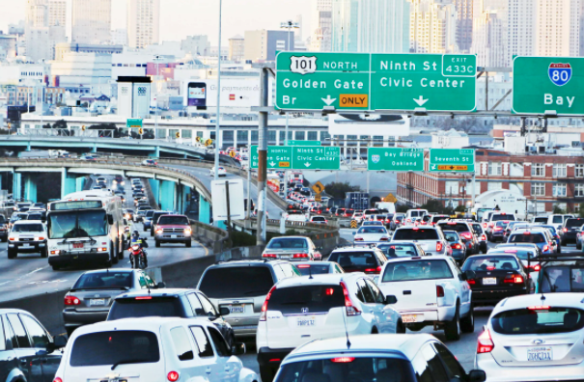
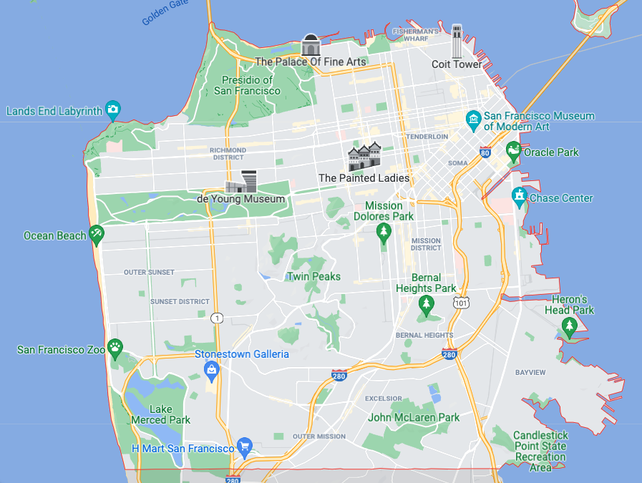

Why us?
SF we thought
Features:
Provide extremely fast and easy delivery service.
Drones & round robot delivery.
Service in San Francisco area.
Distribution stations in the city.
Our interaction design requirement is a Webapp.
SF we saw

Slide 4
Background - Key Assumptions
Company Assumptions:
The company holds the technology to run both air drones and robots with legal permission from the government.
The team now has 8 software developers, including 2 tech leads
The company has 3 distribution centers in SF, for drone, robot, and package storage
Each distribution center has unlimited space, drones and robots
Customer Assumptions:
Our customers want the item to be delivered in a single day.
Service Assumptions:
Each air drone and robot has limited weight capacity, and speed capacity.
The drone will travel in a straight line, while the robot will travel with a real routine offered by Google Map API.
The real time traffic will not be considered in the MVP.

Slide 5
Background - User Requirements
Customer Need & Segmentation
Speed oriented: light-weight packages to be delivered at the fastest speed
Suitable delivery method: drones
Economical: heavy packages to be delivered in a more economic way
Suitable delivery method: robots
User Roadmap
Register/Login
Place Order
Complete Transaction
Input Package Info
Choose Delivery Plan
Checkout
Tracking
Enter basic information such as name, username, email, password to create account and login.
Provide package information and requirements such as name, weight, size, fragile, receiver address, delivery appointment.
Factors considered when delivery plans are generated: route, number of drones/robots available in each station. Users can choose their favorable delivery plan by price or speed.
Users can confirm their order, add their delivery plan to cart and checkout.
Email notification would be sent and real time google map tracking is provided.
Notes:
我们分析了目标用户的需求，并把他们分成两类：追求速度型和经济适用型。第一种用户群体会有更轻量的包裹，比如文件，但是需要以更快的时间送达。我们可以用无人机来满足他们的需求，因为无人机可以走直线，更快。第二种用户群体包裹更重，更倾向于经济适用的寄送方式。我们可以用机器人来满足他们的需求，因为机器人可以承载的重量更大。
这里有一个清晰的用户使用路线图，我们的平台在满足用户的需求的同时，也非常方便实用。用户使用我们产品的流程可以分成三步：注册登录，填写订单信息，以及结账交易。具体每一步是如何实现的会在后面提及。

Slide 6
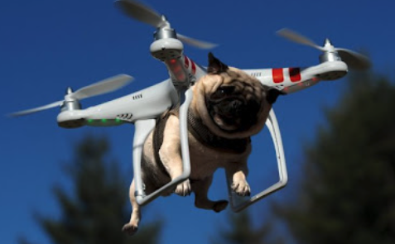
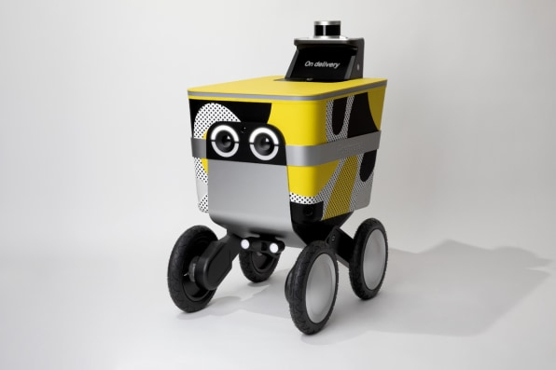
Background - Core Features
Register
Register with email and password, first name and last name and so on
Signin
Login in through email and authentication
Package input
Package information, size, weight, destination and so on
Input information validation (google API to check correctness of address, package information like size, weight will be validated using our internal setting)
Option selection
Dispatch Drone or Robot through 3 distribution centers
Drone : Find the shortest distance through air
Robot: Find the shortest path on Google Map
Different prices based on different speed
Package management
Similiar to wishlist to store the items to be used in the future
Easier for user to update, delete and track the orders to be added into the cart
Chekout
Pay for the service rendered based on unit price and distance
Tracking
Realtime Tracking and Google Map Marker
Noification
Notification mail will be sent to user’s mail address with a tracking number

Slide 7



Background - Technical Design
Frontend: ReactJS
Router
Component
Service
Database: MySQL
Backend: Java
Tomcat
Spring

Slide 8
Background - Technical Design
Tech stack：frontend (React), backend (SpringMVC, Spring Security), database (MySQL, hibernate)
Why using these tech stacks?
Pros:
React has better performance than other frameworks.
Spring MVC has more flexibility, which offers developers full control of HTML, convenience to test and to integrate extensions into framework.
Spring Security provides developers Servlet API integration, Spring MVC integration and some protections for the website.
MySQL is a secure and reliable DBMS, which is ideal to store web application data, and Hibernate can be applied to different kinds of databases and have good performance and high efficiency due to the use of HQL.
Cons:
React can only be applied to the View part, so developers have to use other technology to implement other parts of the project.
Spring Framework is too complex to quickly get started.

Slide 9
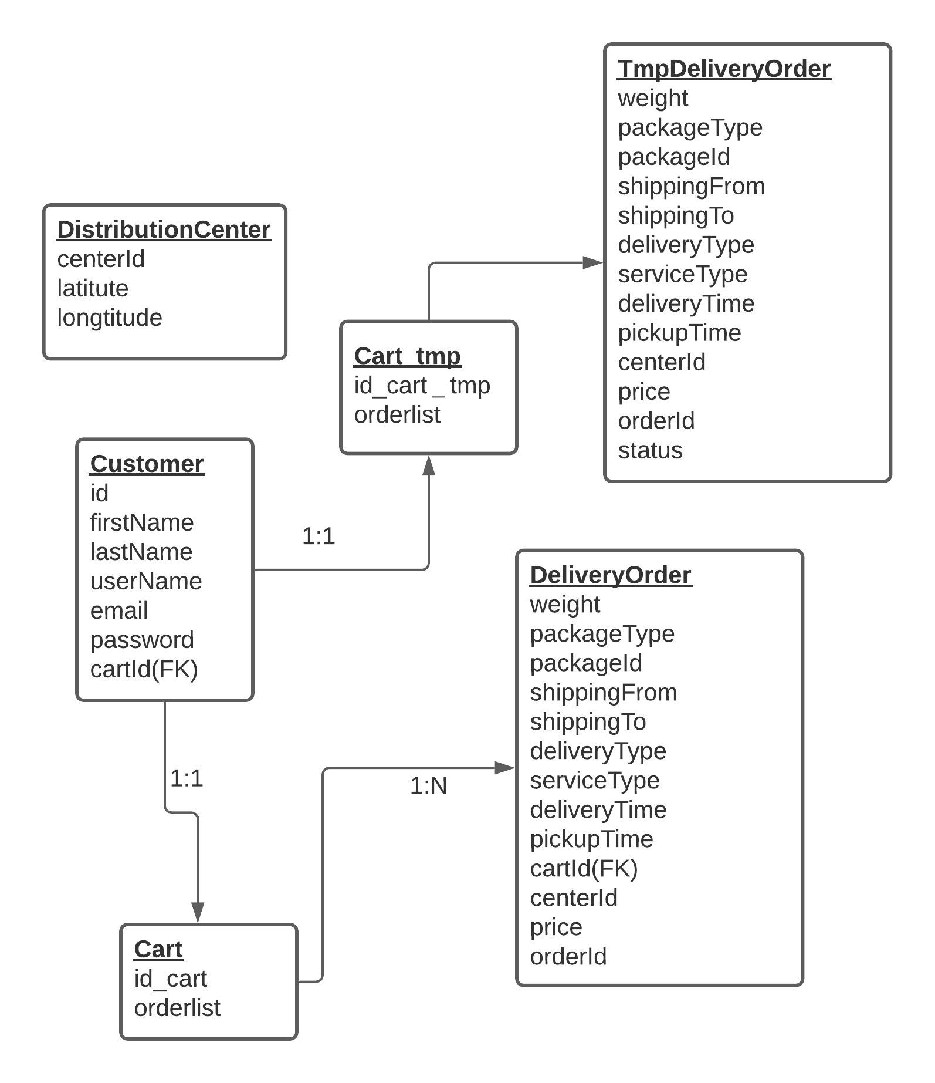
Database Design
Distribution Center:
Store the position and id of three distribution centeres.
Customer:
Store customer’s information and corresponding cart.
Cart:
Store list of orders.
DeliveryOrder:
Store the ordered package information.
Tmp. delieveryOrder:
Store the package information which hasn’t been added into cart.

Slide 10
Login/Register
Notes:
我们的注册登陆页面十分简洁，所以用户可以花费很短时间就完成这一步骤。只需要姓名，用户名，邮件和密码就可以注册一个新账号。这里有一个动图，显示用户是如何在我们的网站注册登录的。

Slide 11
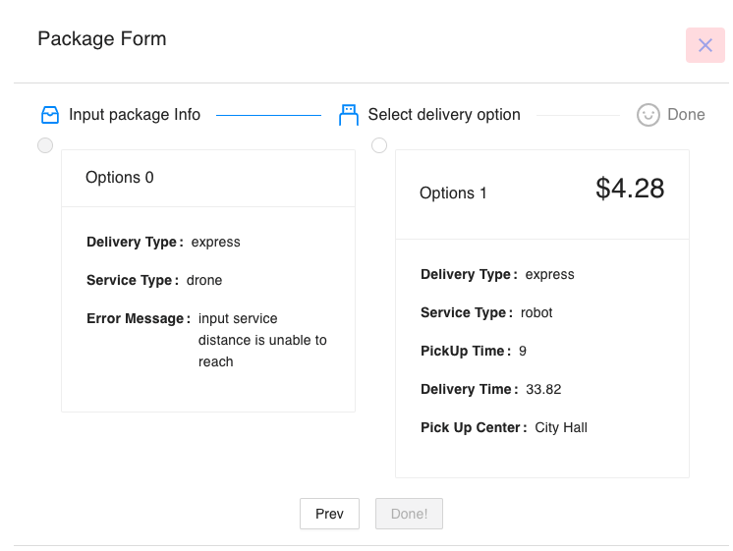
2.1 Package Input & Delivery Options
Invalid options
weight / location
valid options
estimated time / price

Slide 12
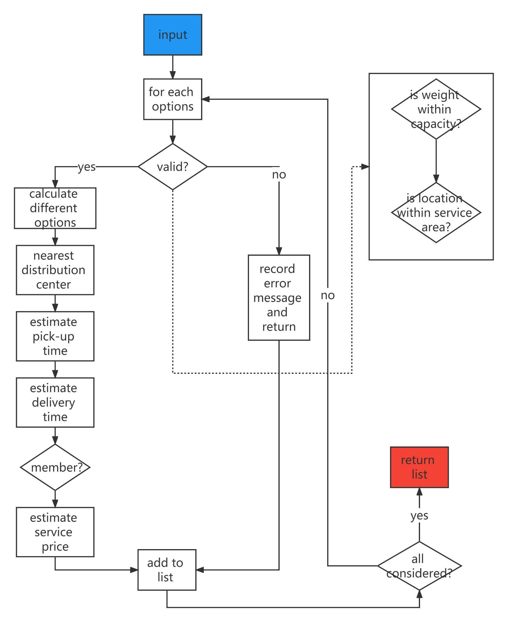
2.2 Option Algorithm
Two options: drone & robot
Corner case check
weight
location
Calculate pick-up time and delivery time
drone: straight path / robot: car path
find nearest distribution center (priority queue) and calculate the estimated pick-up time
calculate the estimated delivery time
Calculate the service price
check if user is a member
based on pickup & delivery time
Notes:
基于的假设：
drone走直线、robot走车的路线
drone、robot有重量限制和最大路程限制
计算的结果：
pickup time、delivery time
service price
计算的过程：

Slide 13
3. Package List
Plan to send a package but not sure about the details?
No big deal, you can save a draft order and edit/delete/checkout it at any time!
Package information will be sync with our database, and no need to worry losing them

Slide 14
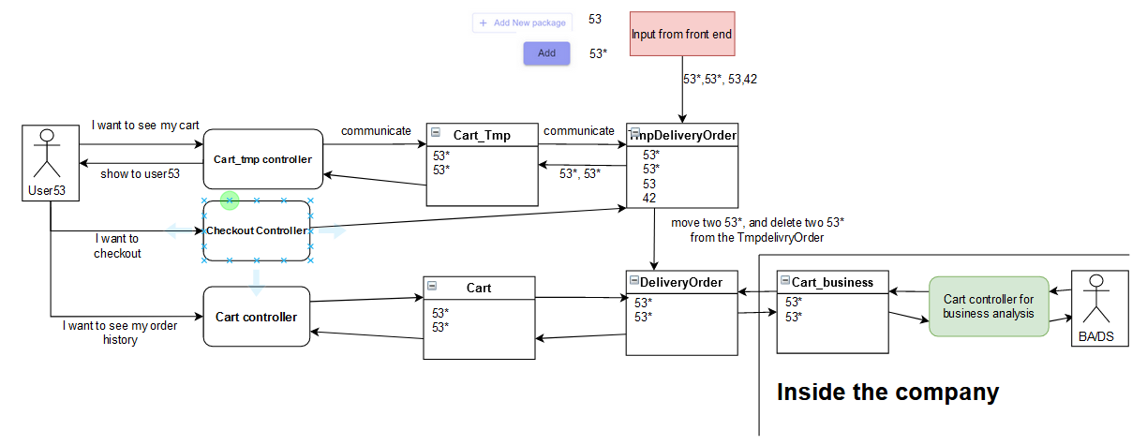
4. Cart & Checkout

Slide 15
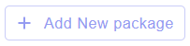
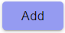

4. Cart & Checkout
53
Frontend Input
53*
inputs: 53*, 53*,
53, 42
view cart
Cart_tmp controller
communicate
show 53*, 53*
return 53*, 53*
Cart_Tmp
TmpDeliveryOrder
communicate
53*, 53*
return 53*, 53*
53*, 53*, 53, 42
checkout
Checkout
controller
communicate
move two 53* from Tmp DeliveryOrder to DeliveryOrder
User 53
Cart
DeliveryOrder
Cart_business
view order history
53*, 53*
53*, 53*
53*, 53*
Cart
controller
cart controller for business analysis
View cart process
Checkout process
BA / DS
View order history process
Inside the company

Slide 16
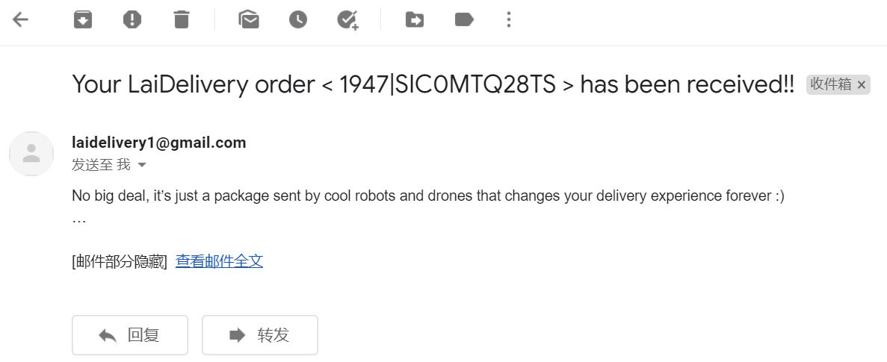
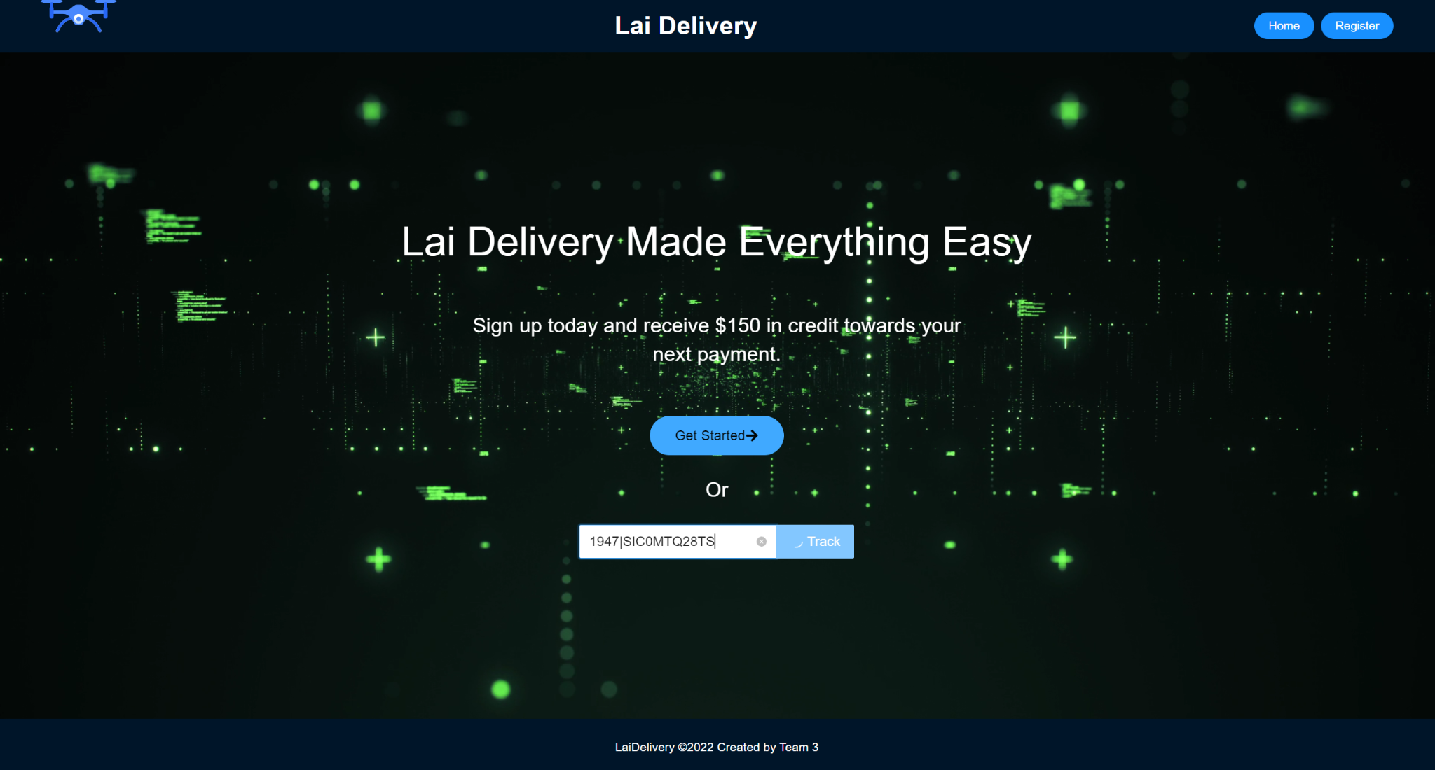
5. Email Notification
Feature:
Adopted Java Mail to send order confirmation email with tracking number
Pros:
Simple but efficient
Obvious tracking number which can be used to tracking package easily

Slide 17
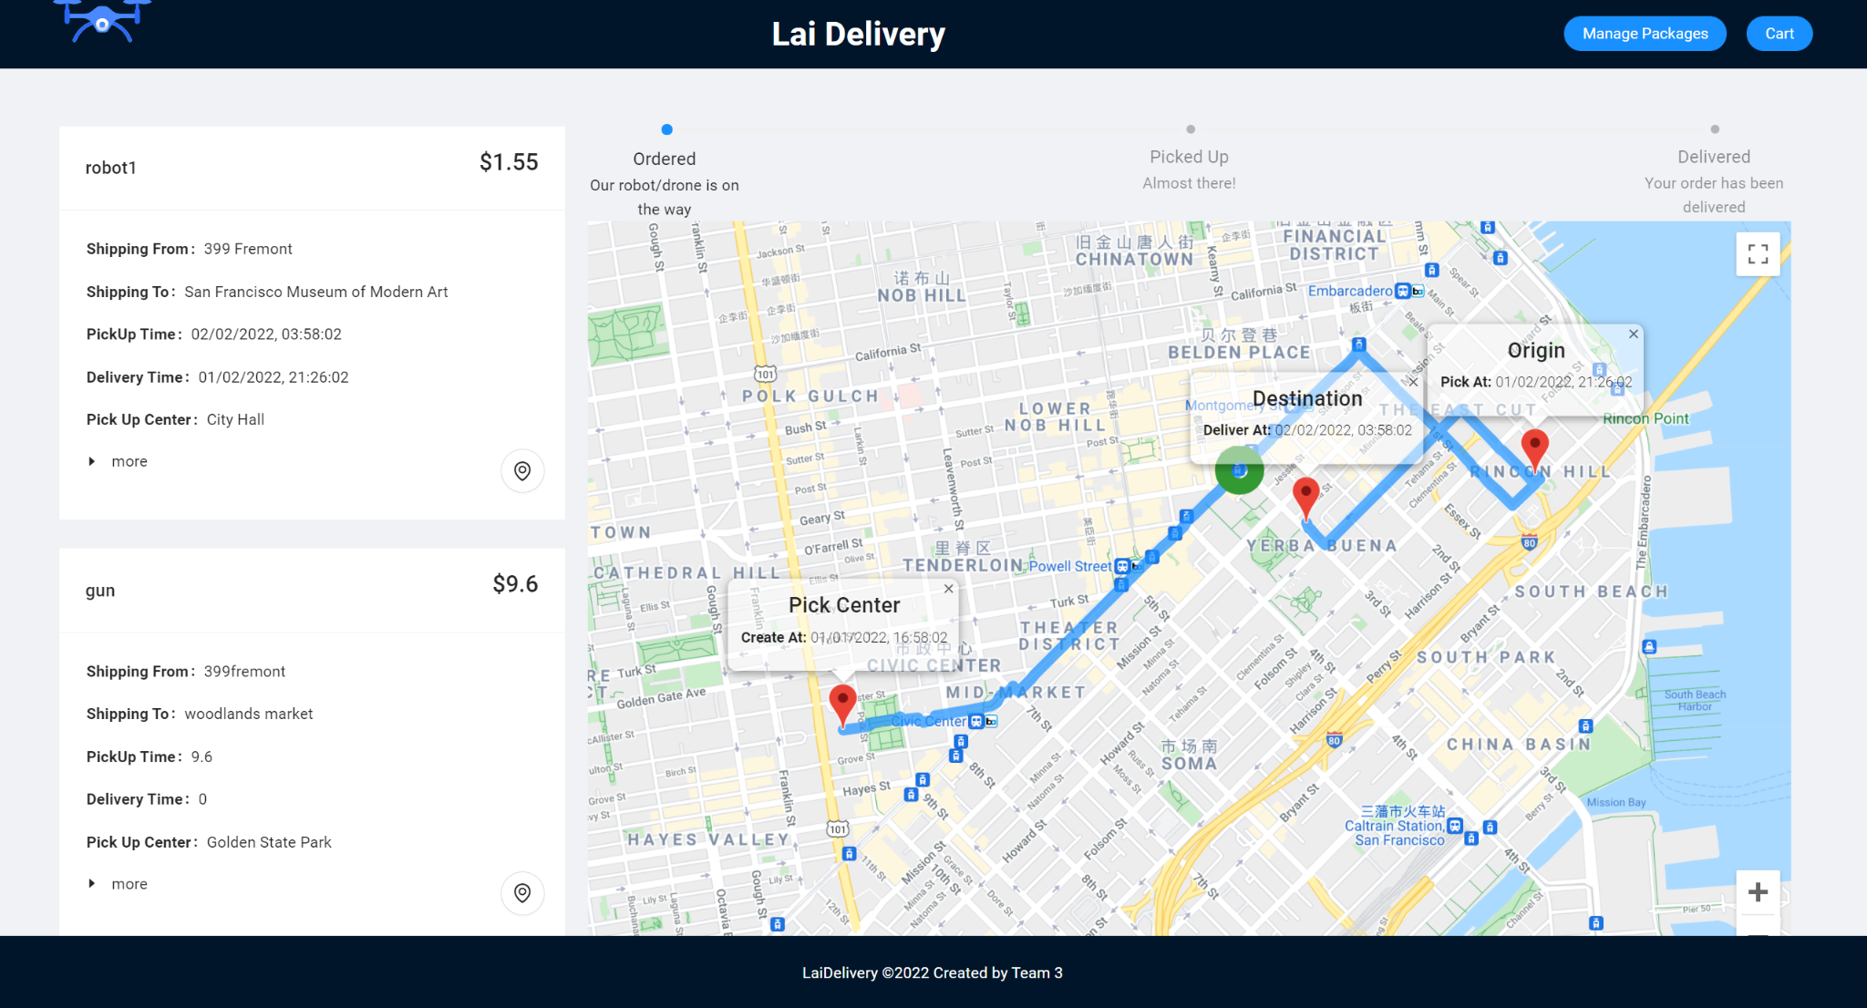
6. Track & Order History
Clear order status and description
Ultilized Google Maps API to dynamically show the delivery path of the drone and robot
Elegant order information card
Easy to switch different package and track it

Slide 18
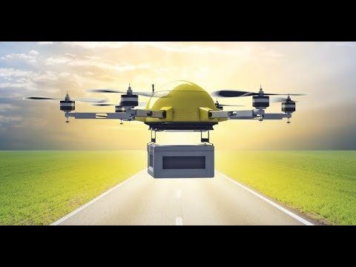
Demo

Slide 19
Product Roadmap
To be completed
Completed
Better UI Design
Final Advance
(3.0)
Register
Signin
Package input
Option selection
Package management
Chekout
Tracking
E-mail notifiation
More options provided
Schedule pickup & deliver
Realtime tracking system
Advance (2.0)
MVP (1.0)

Slide 20
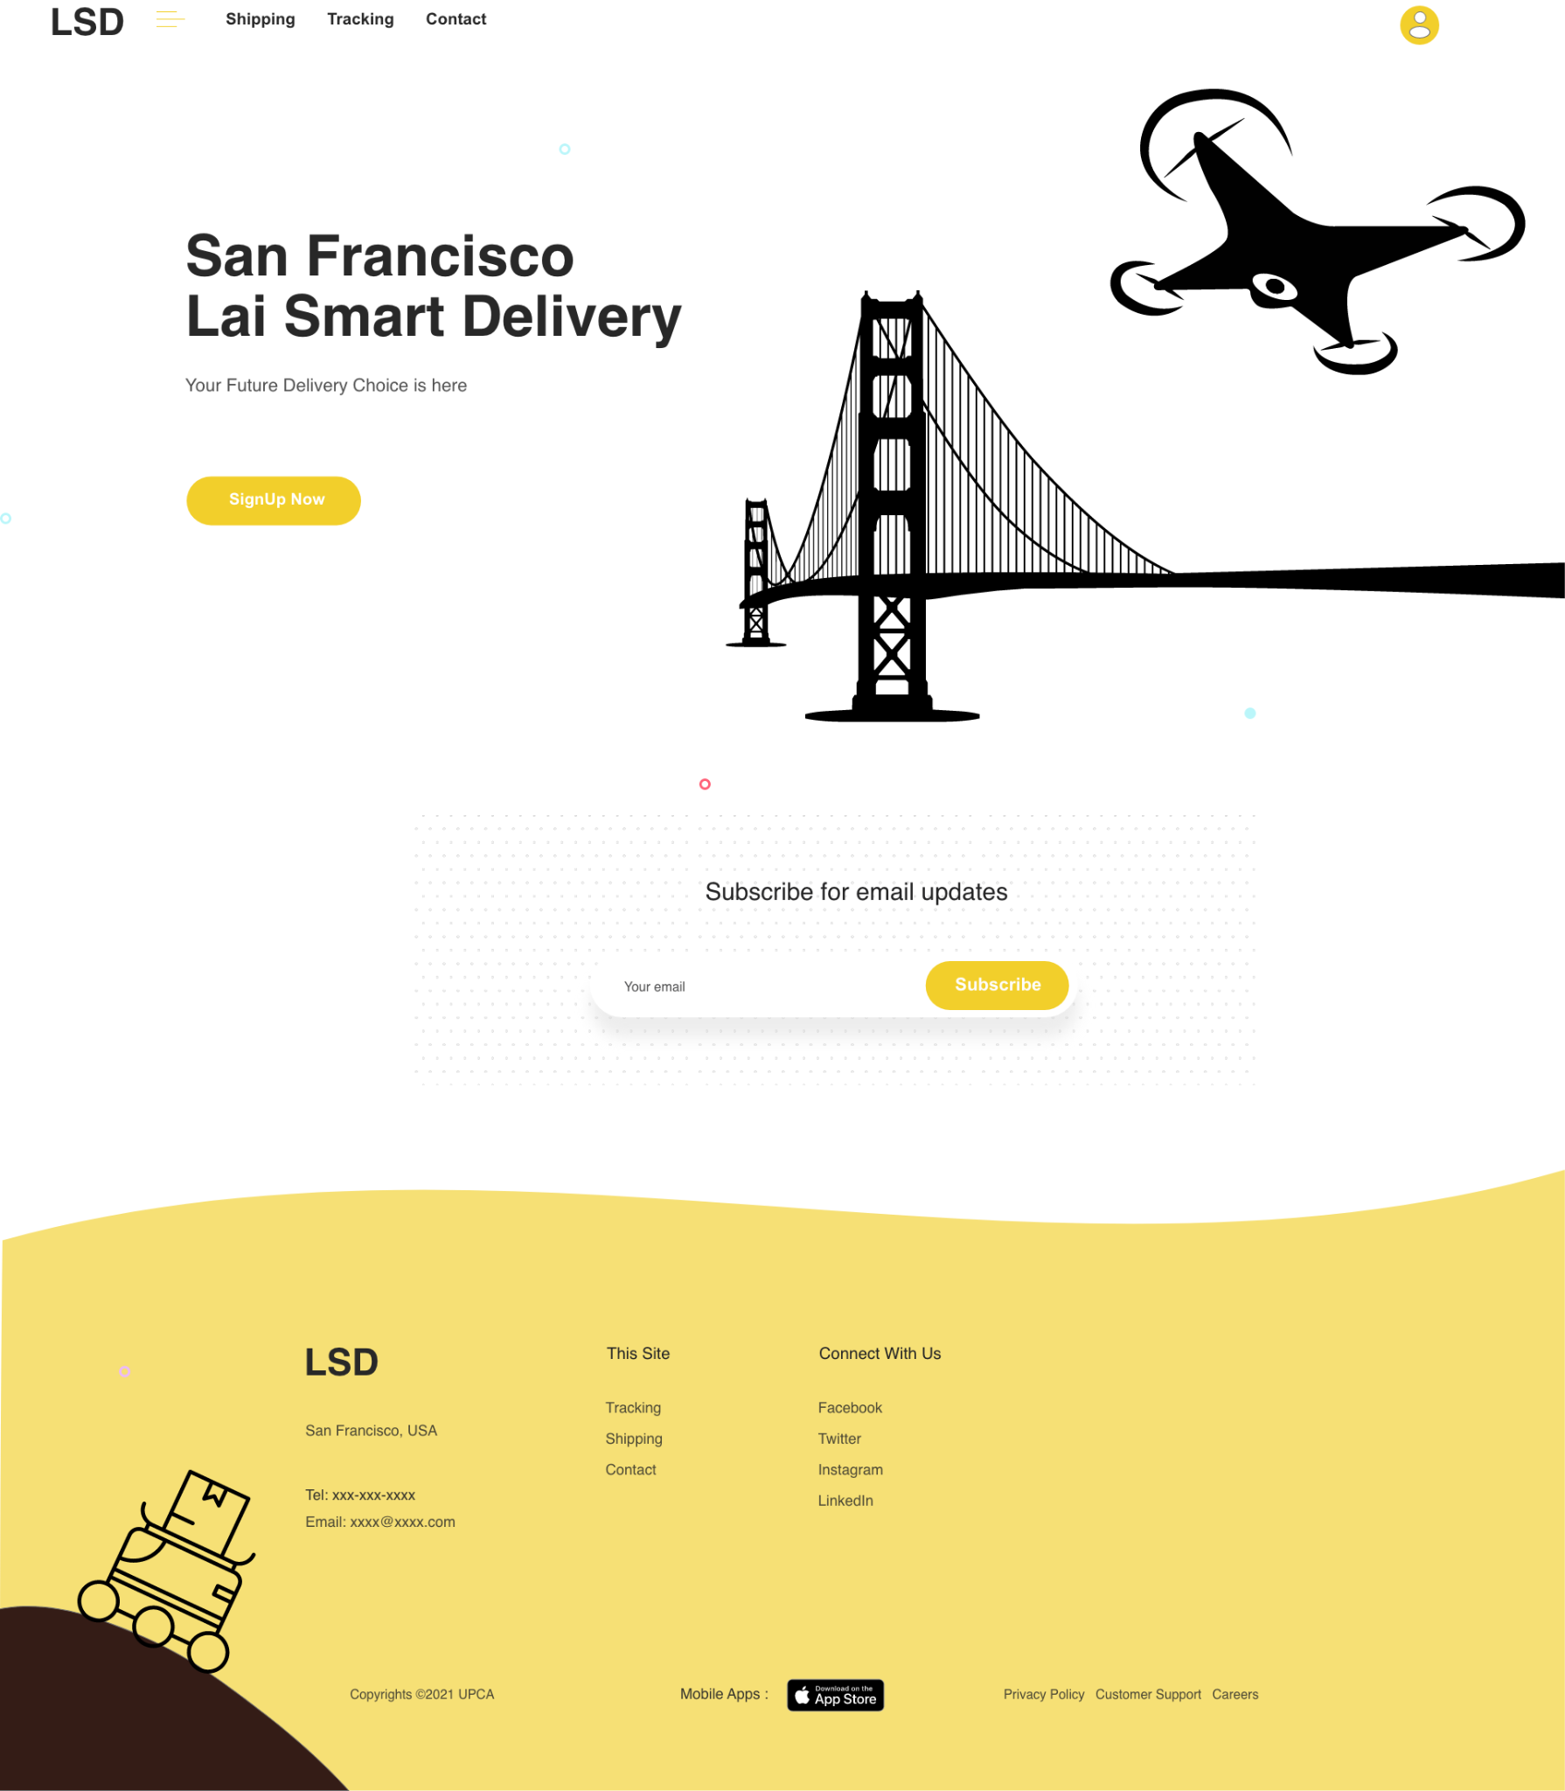
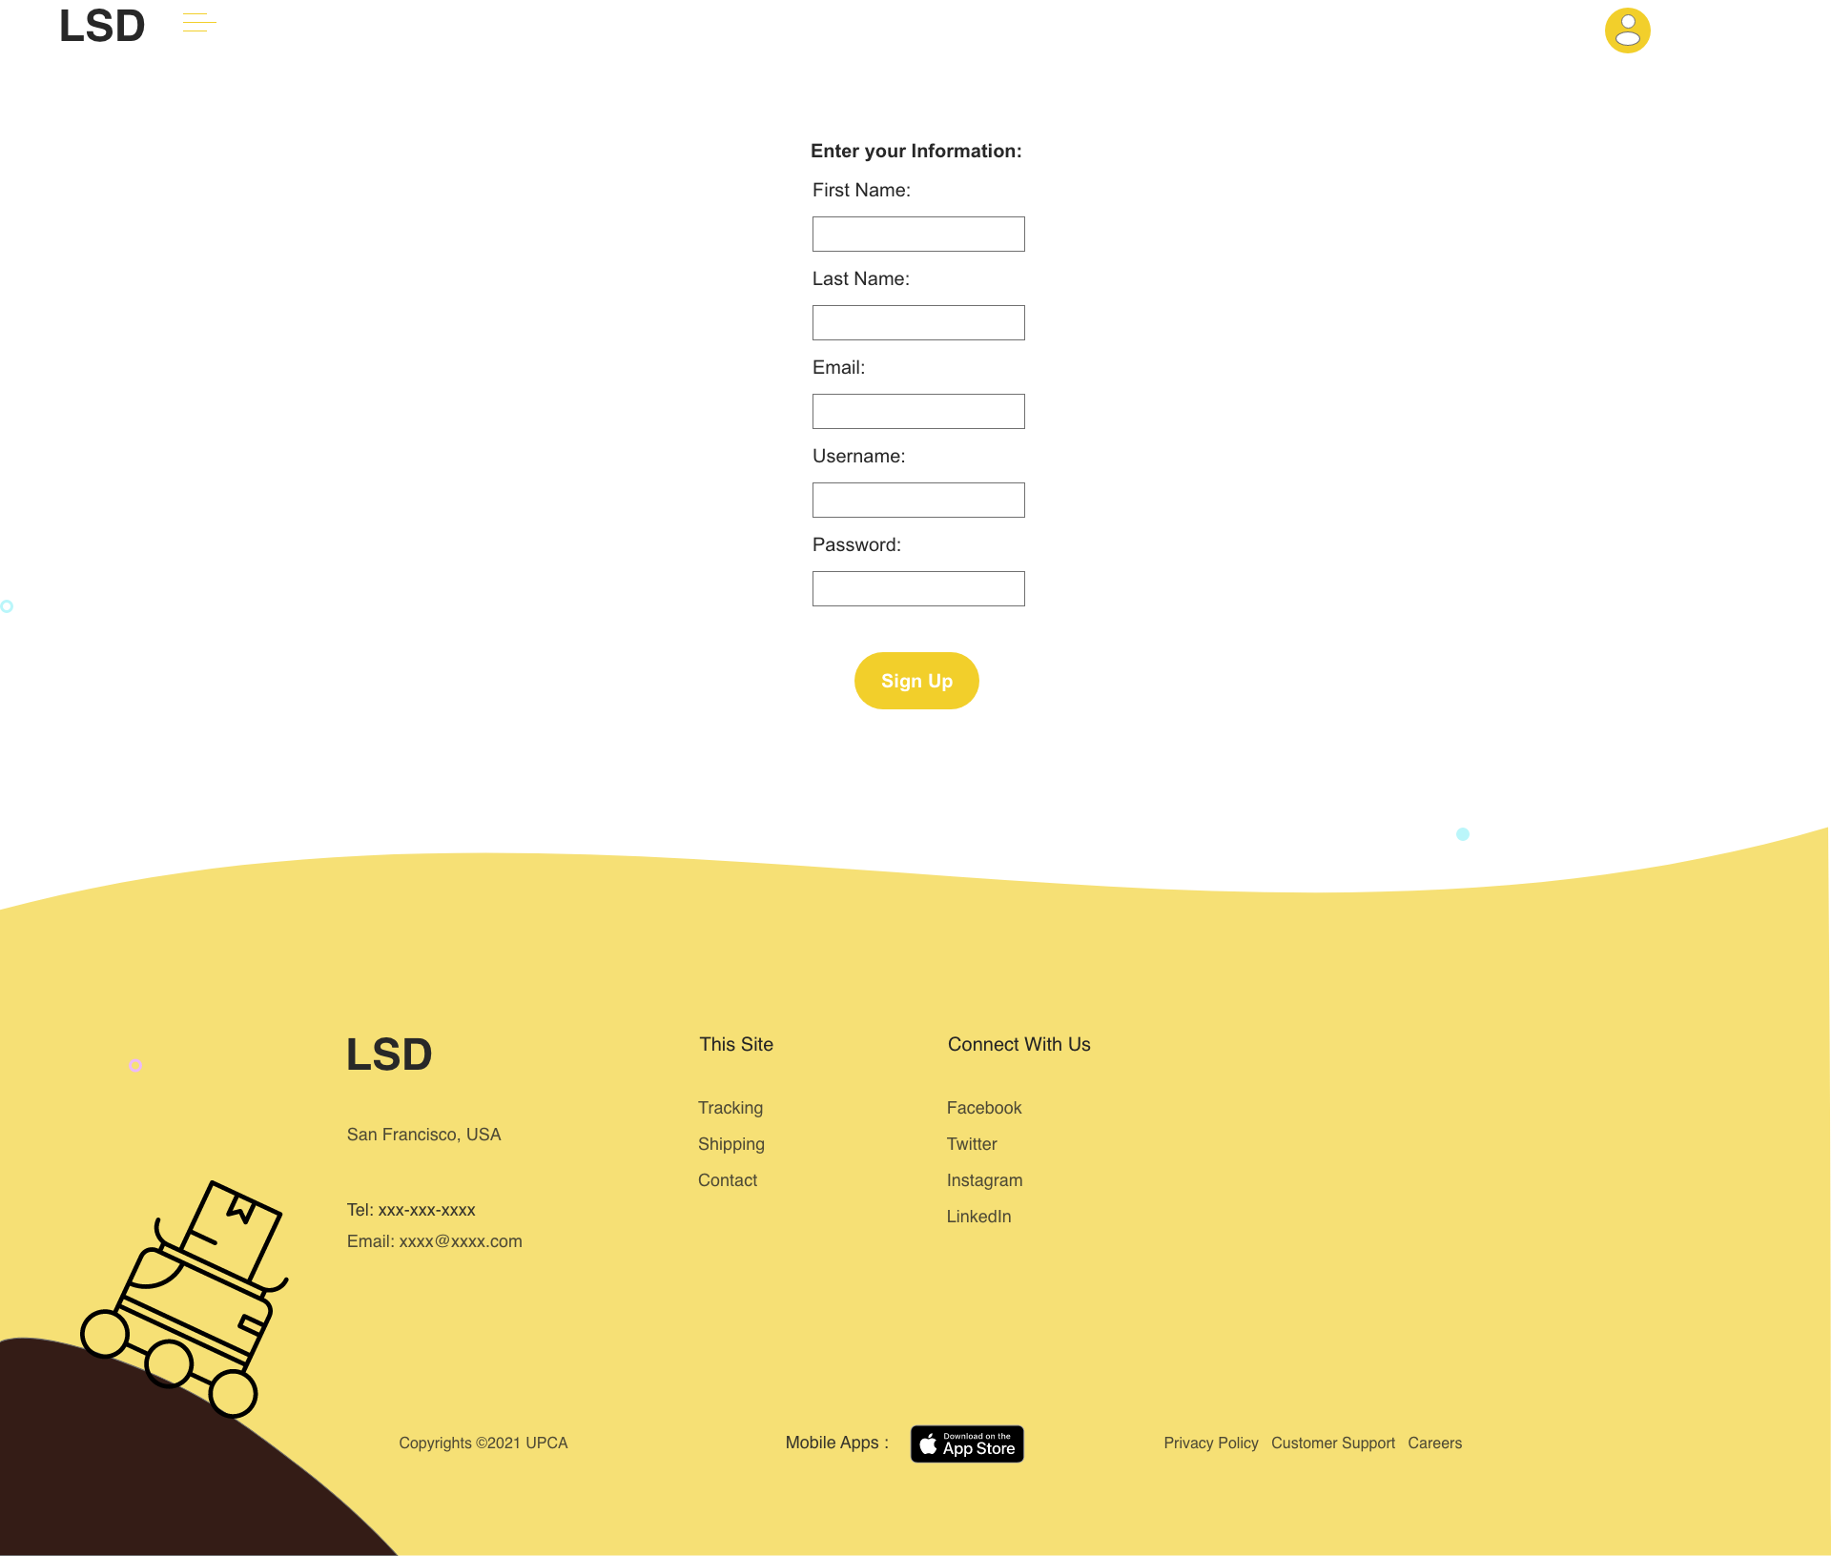
Better UI design

Slide 21
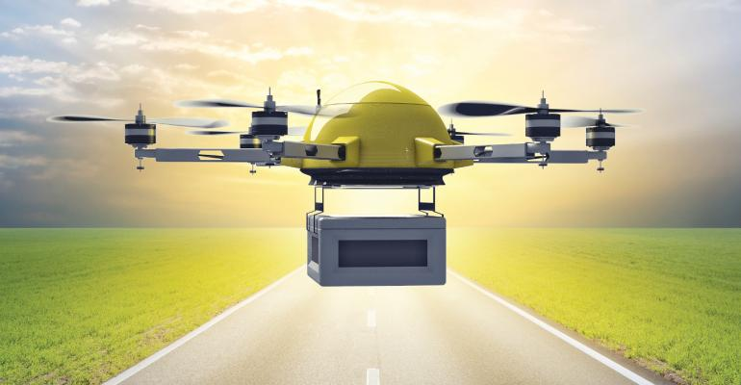
Q & A

Slide 22
Appendix

Slide 23
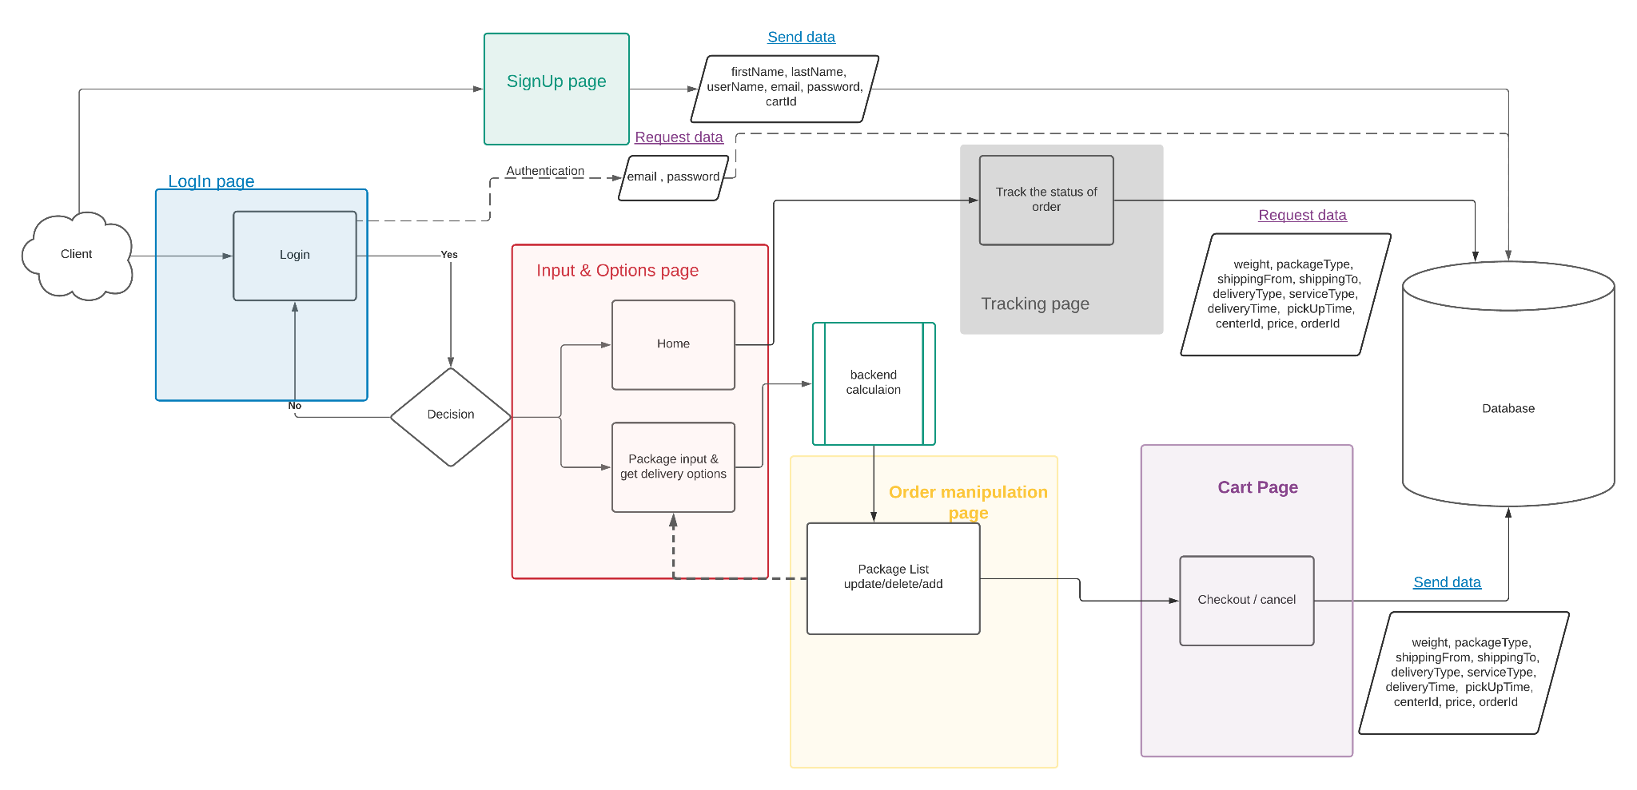
Work Flow Design

